Slide 1
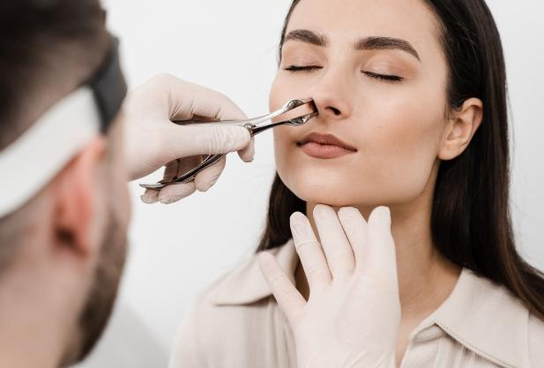
Anterior rhinoscopy

Slide 2
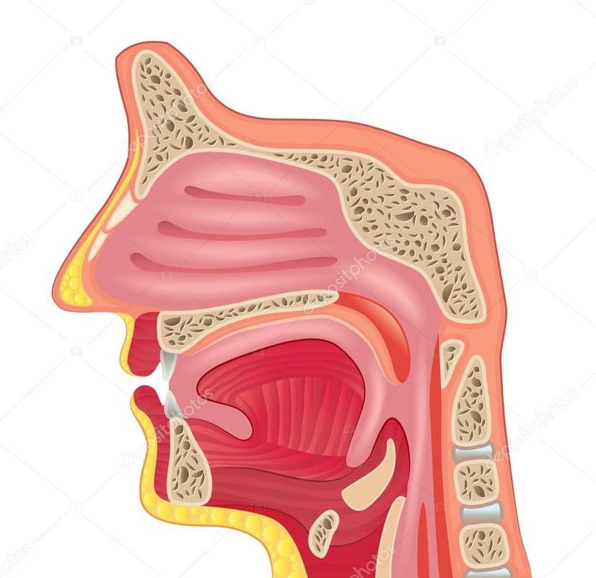
Anterior nasal openings – nostrils.
The nasal cavity is divided into:
Nasal vestibule – the anterior part, lined with hair (vibrissae), having a protective role .
Proper nasal cavities – cavities lined with mucosa, through which inspired air circulates.
Anterior nasal opening- nostrils
Posterior nasal opening - choanae

Slide 3
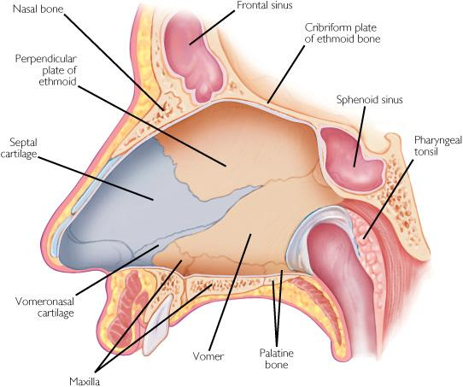
Nasal septum Divides the nasal cavity into two nasal fossae. It is composed of:
Bones (the vomer and the perpendicular plate of the ethmoid bone)
Cartilage (the septal cartilage)

Slide 4
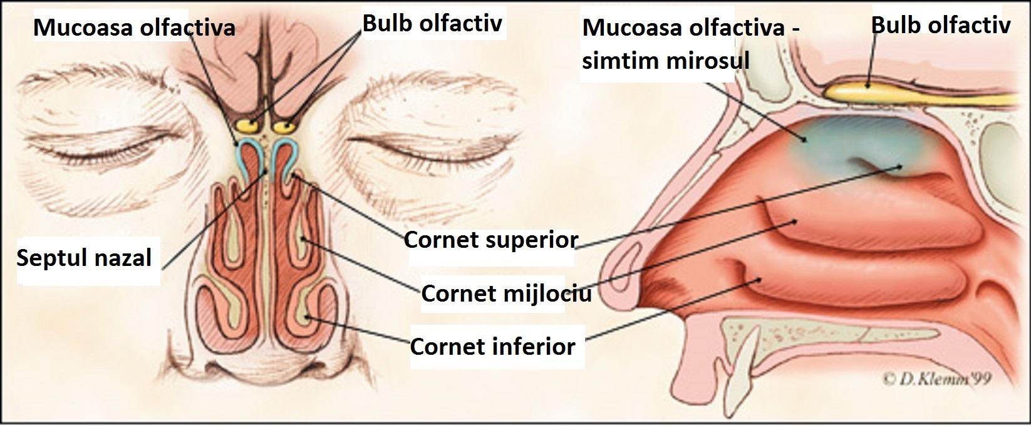
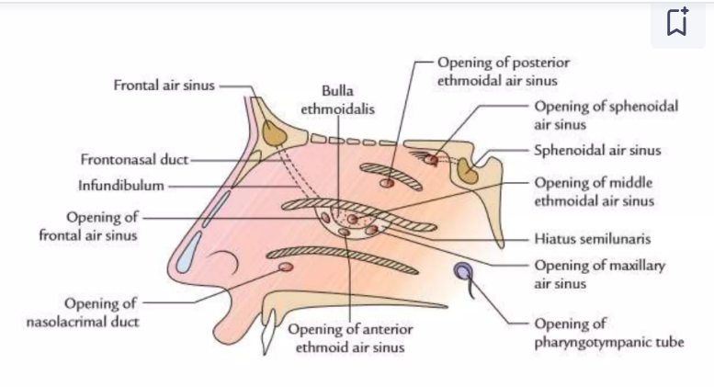
Lateral wall of the nasal fossae
Nasal turbinates
Nasal meatuses – between the nasal turbinates, where the paranasal sinuses and lacrimal ducts open.

Slide 5
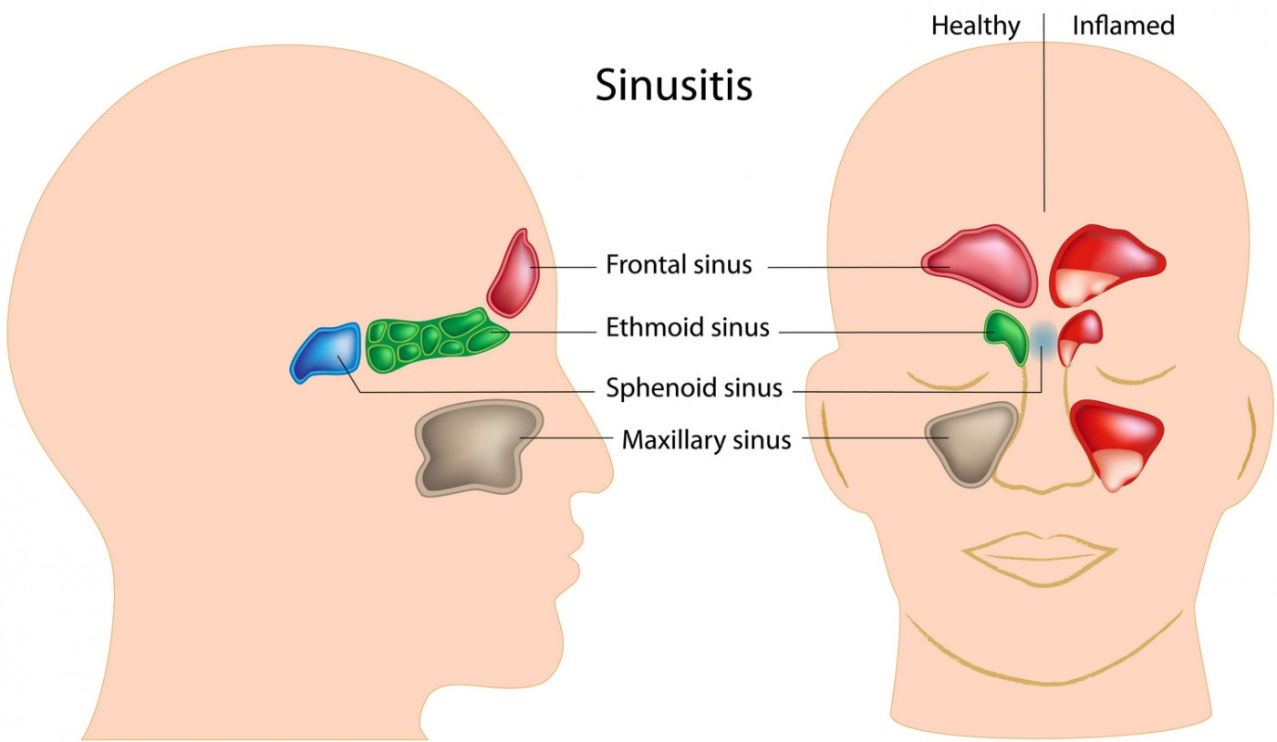
Paranasal Sinuses Air-filled cavities that communicate with the nasal fossae, contributing to the reduction of skull weight and the resonance of sound.
Frontal sinus
Ethmoidal sinus
Sphenoidal sinus
Maxillary sinus

Slide 6
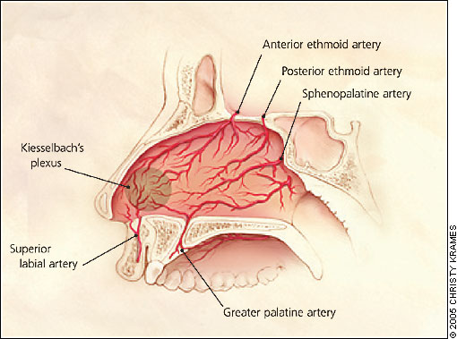
The nasal cavity is well vascularized
Kiesselbach’s vascular plexus (area prone to anterior epistaxis)
Anterior and posterior ethmoidal artery
Sphenopalatine artery
Greater palatine artery

Slide 7
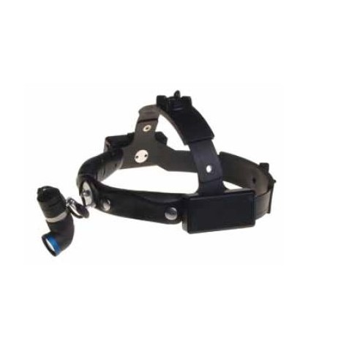
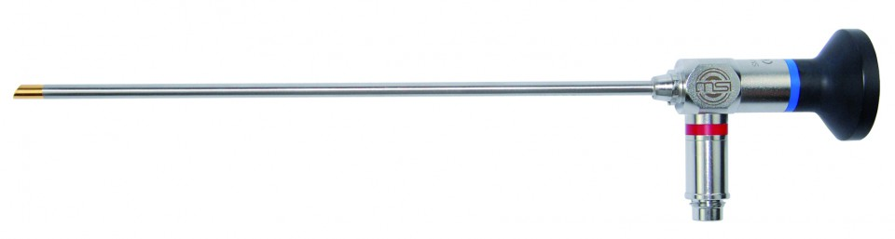
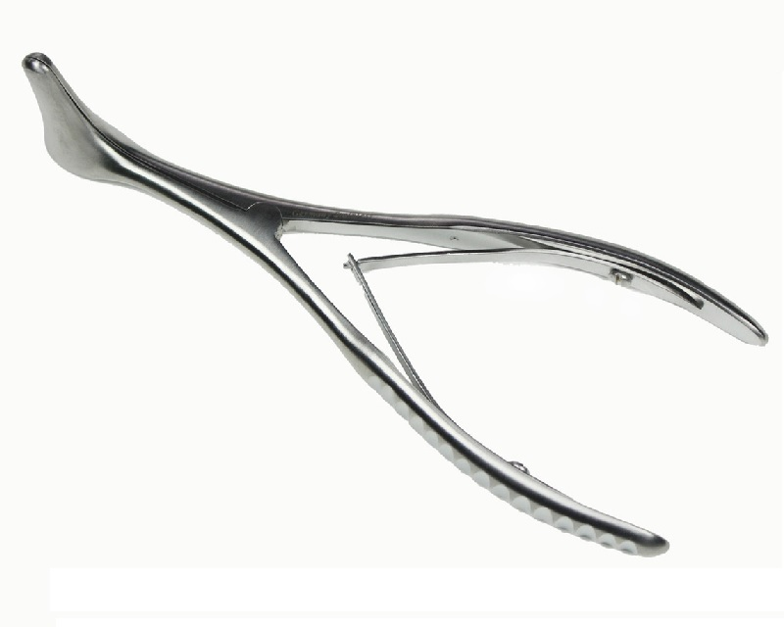
Instruments used in examination

Slide 8
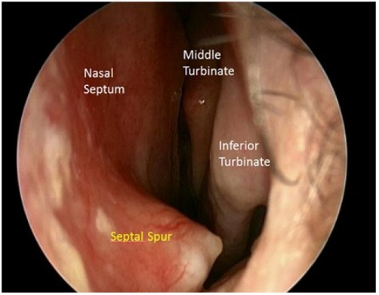
To be examined:
Nasal vestibule
Nasal fossa
Nasal mucosa
Nasal septum
Nasal conchae
Nasal meatuses

Slide 9
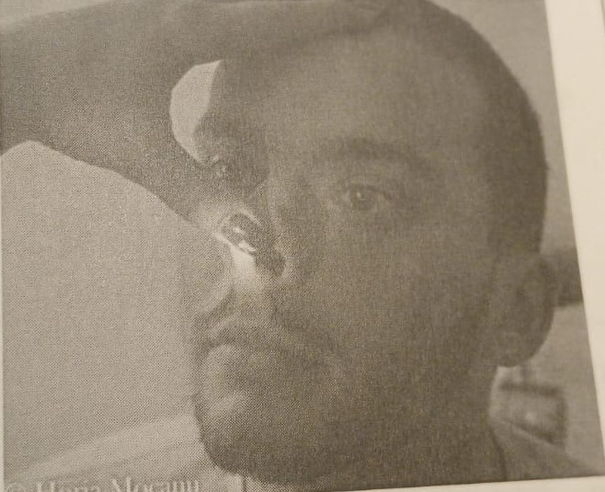
Inspection of the nasal pyramid and lifting of the nasal tip (Narinoscopy) with the left hand thumb.

Slide 10
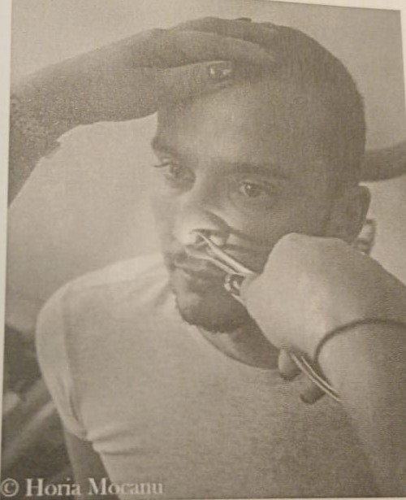
Place your left hand on the patient's head.
Hold the speculum with the correct grip and insert it into the nasal fossa, from bottom to top, in a closed position. Be careful not to injure the nasal septum.

Slide 11
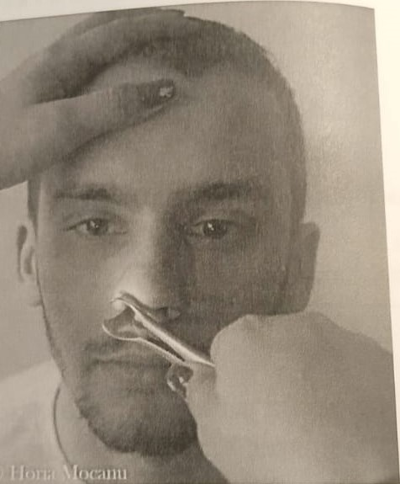
Open the speculum and rotate it gently until its valves are parallel to the floor of the nasal fossa.
Now, slightly tilt the patient's head to the side and then backward to examine the nasal septum and the inferior and middle nasal conchae.
Remove the speculum from the fossa in an open position.
Examine the contralateral nasal fossa using the same technique.

Slide 12
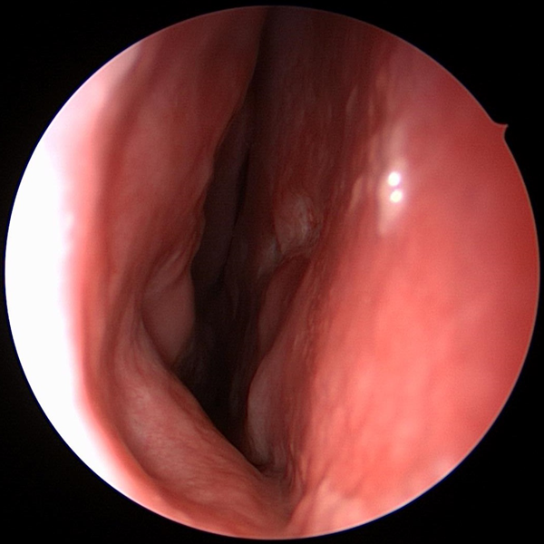
Normal aspects:
Mucosa without inflammation
Nasal septum on the midline
No pathological secretions (serous, mucous, purulent, or bloody)
No nasal polyps
No nasal tumors

Slide 13
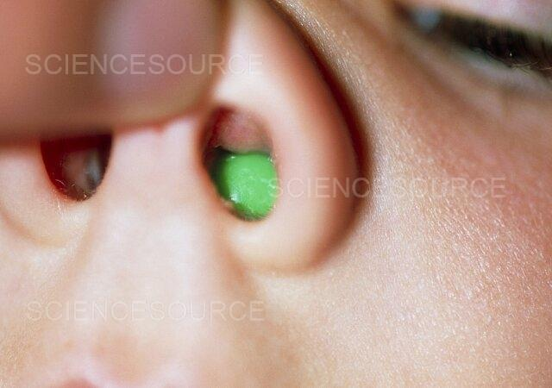
Patological aspects:
Foreign body

Slide 14
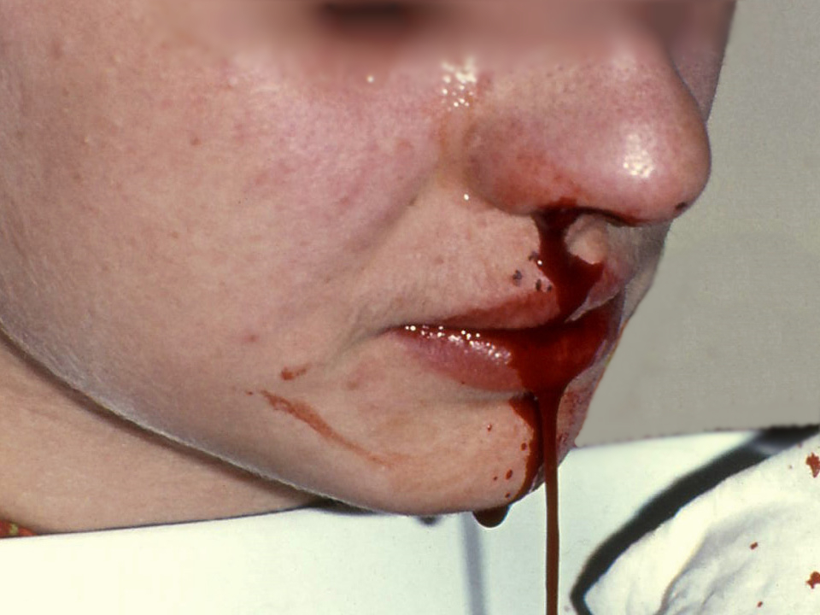
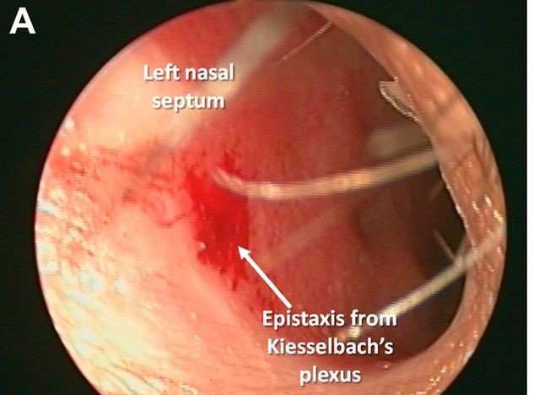
Bleeding (Epistaxis)

Slide 15
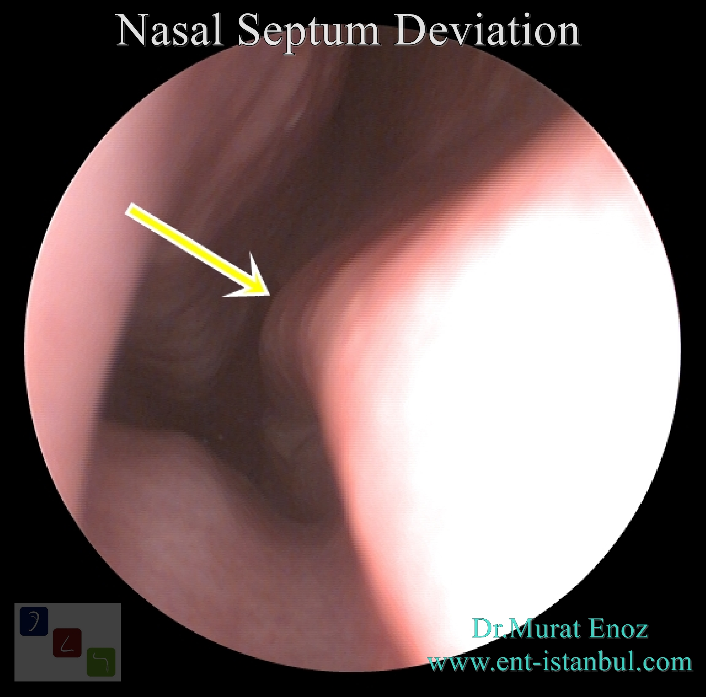
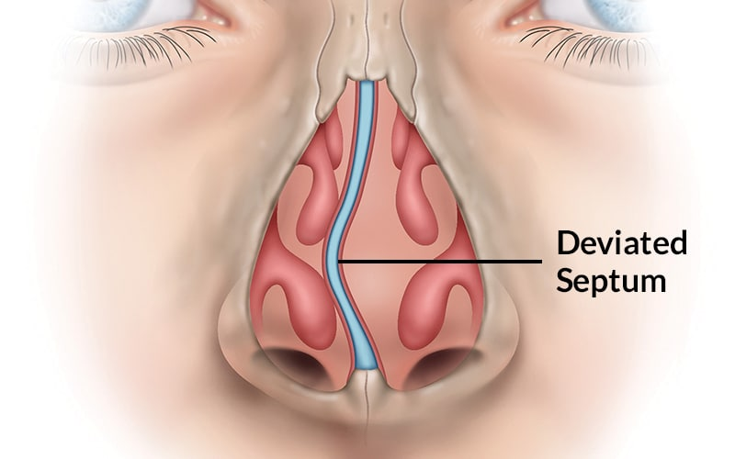
Septal deviation / septal crests

Slide 16
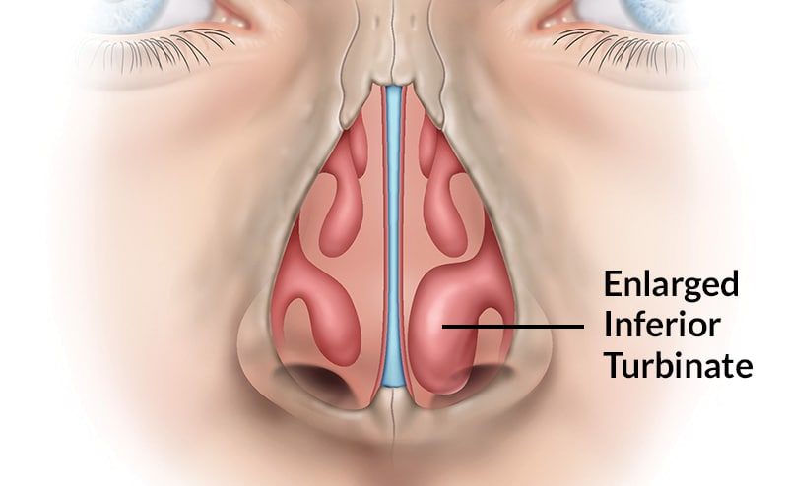
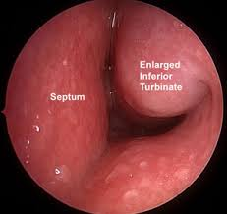
Hypertrophy of the nasal turbinates

Slide 17
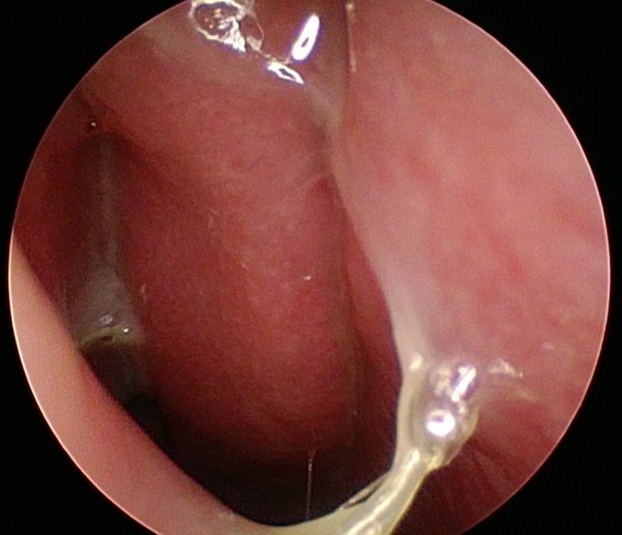
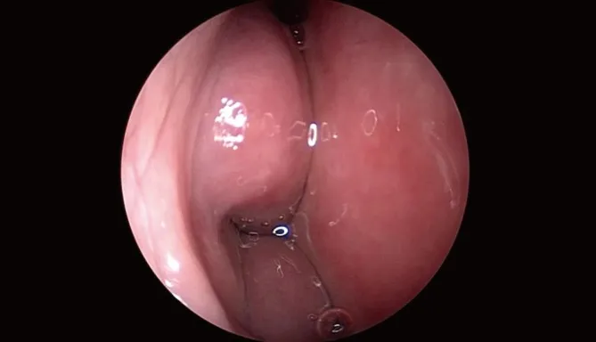
Pathological secretions (serous, mucous, purulent, bloody)

Slide 18
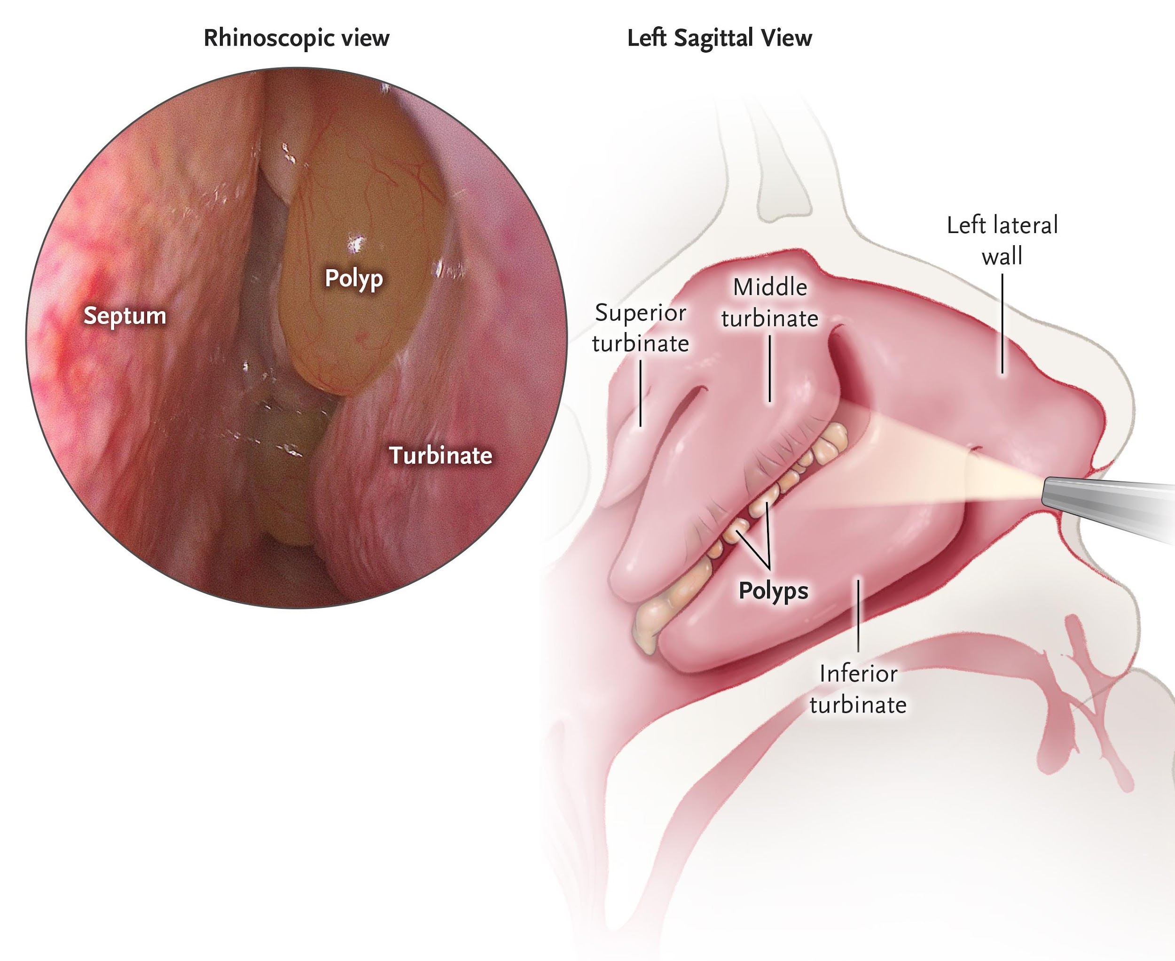
Nasal polyposis

Slide 19
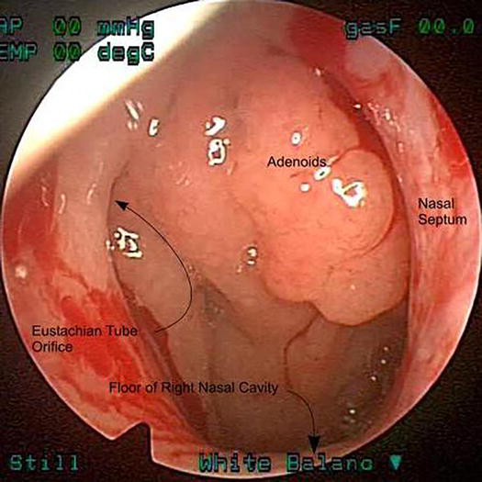
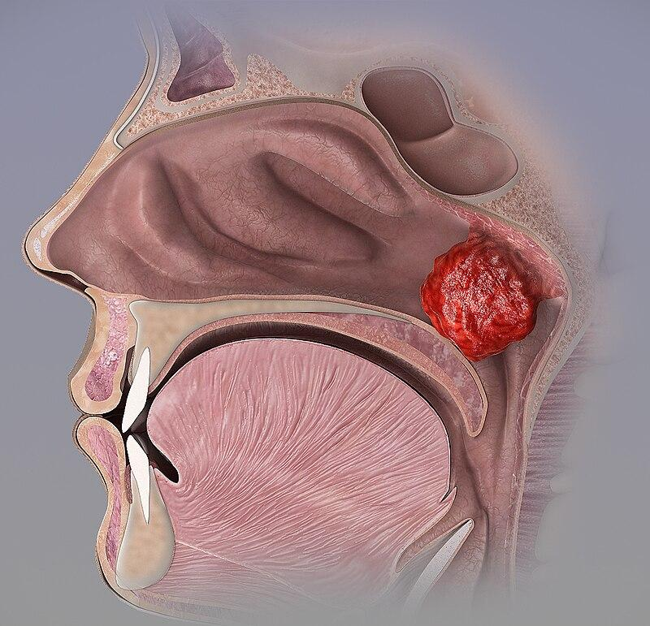
Chronic hypertrophic adenoiditis

Slide 20
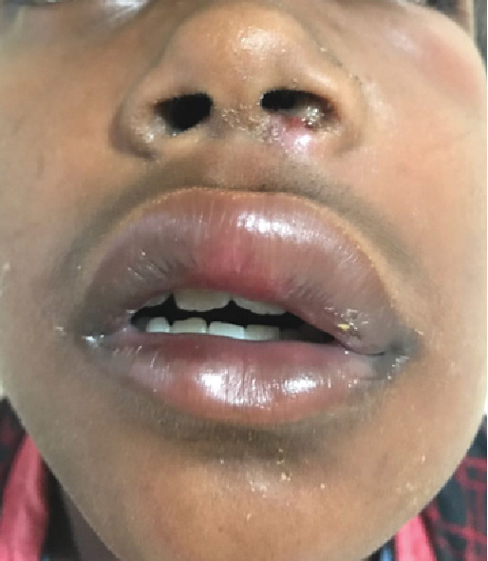
Nasal vestibule furuncle

Slide 21
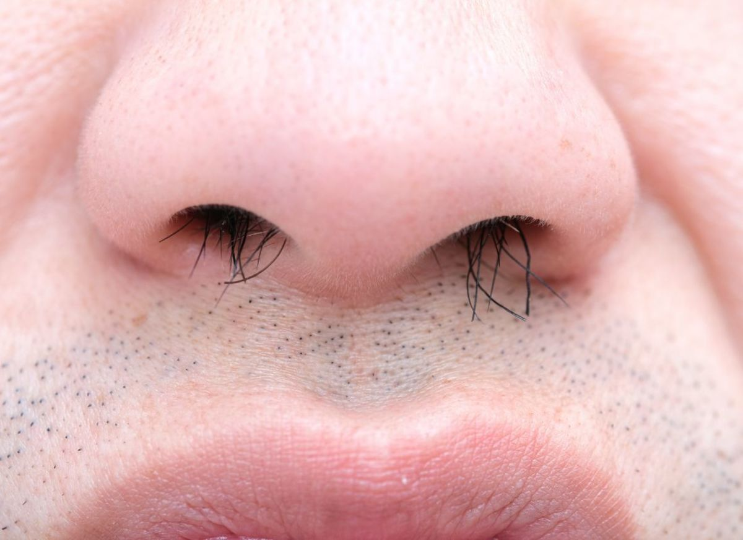
Common mistakes:
Inserting the speculum too deeply or touching the septum may cause pain.
Removing the speculum in a closed position may pull out hairs from the nasal vestibule.

Slide 22
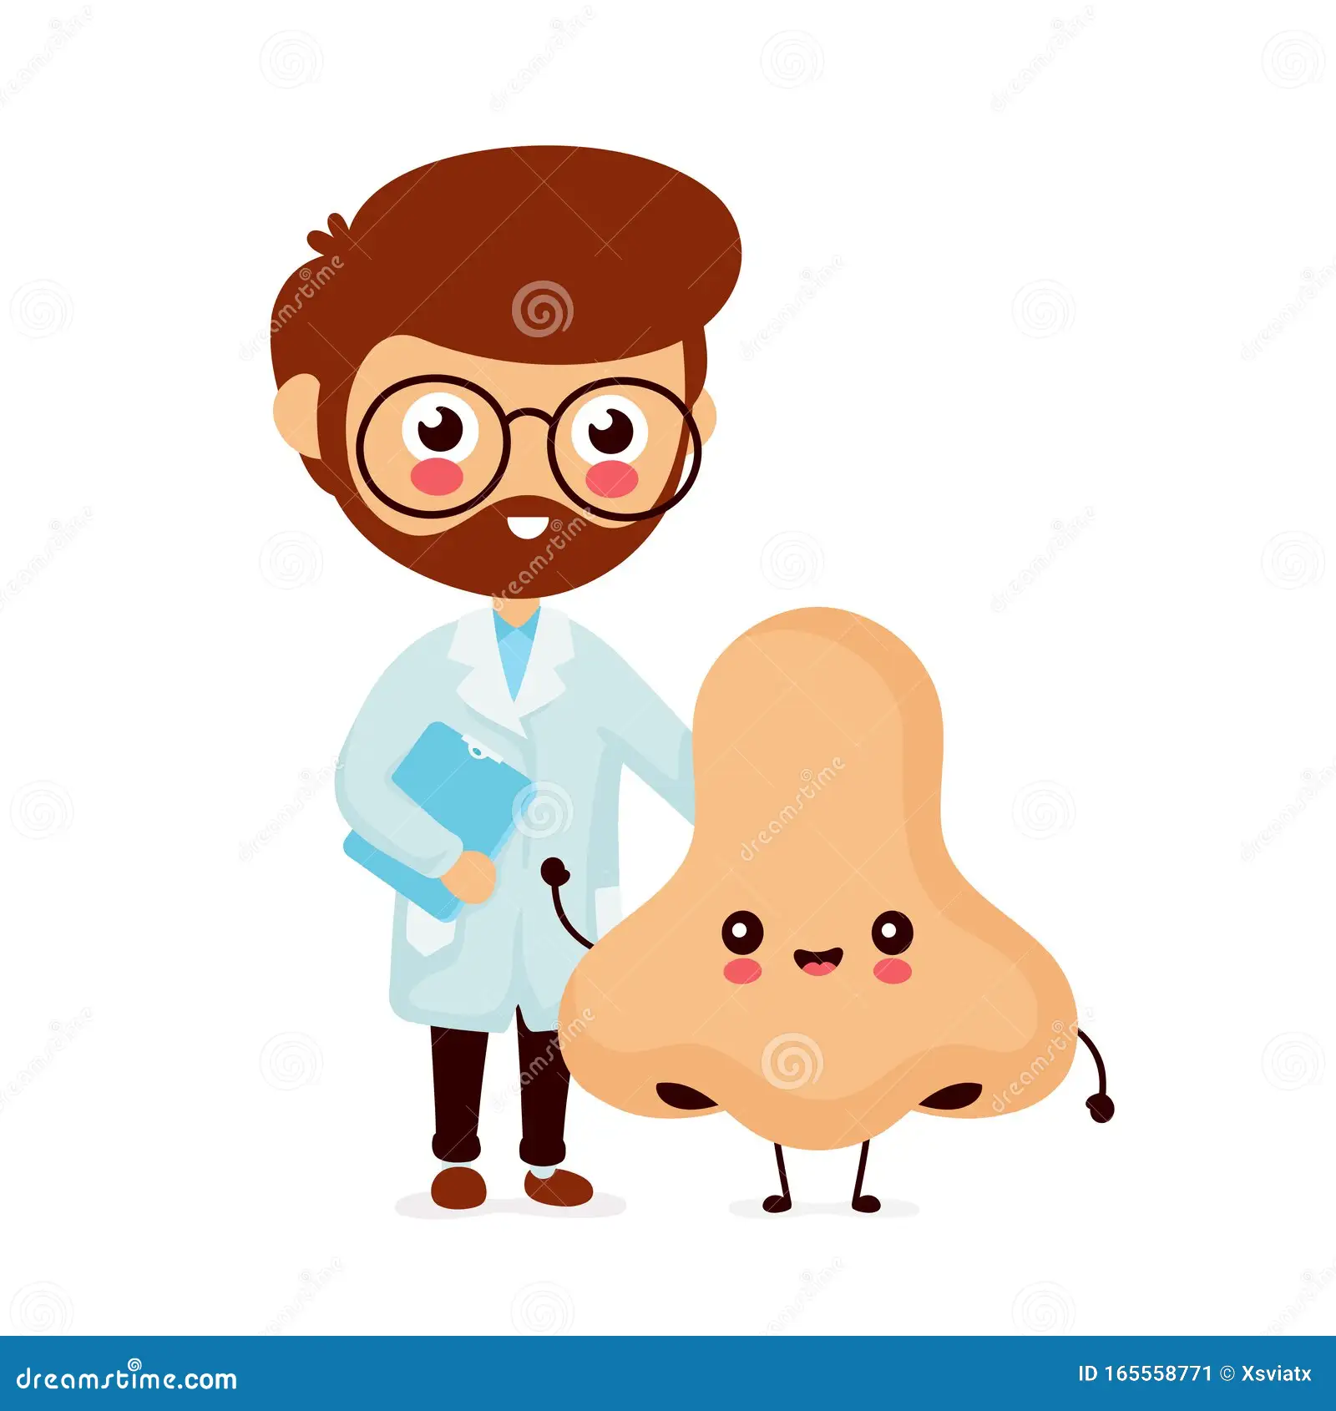
Va multumesc pentru atentie !

